Slide 1
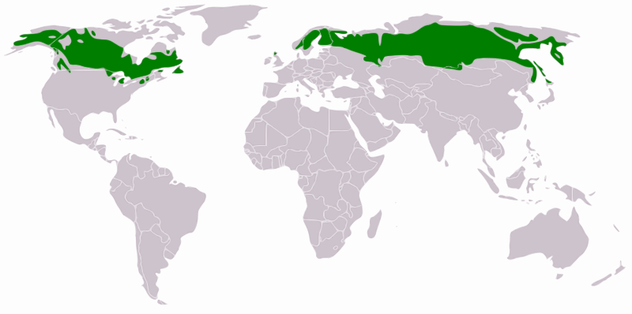
Taiga: Location
The Taiga is one of the three main forest biomes and it is located in the far north between the temperate forest and the tundra.

Slide 2
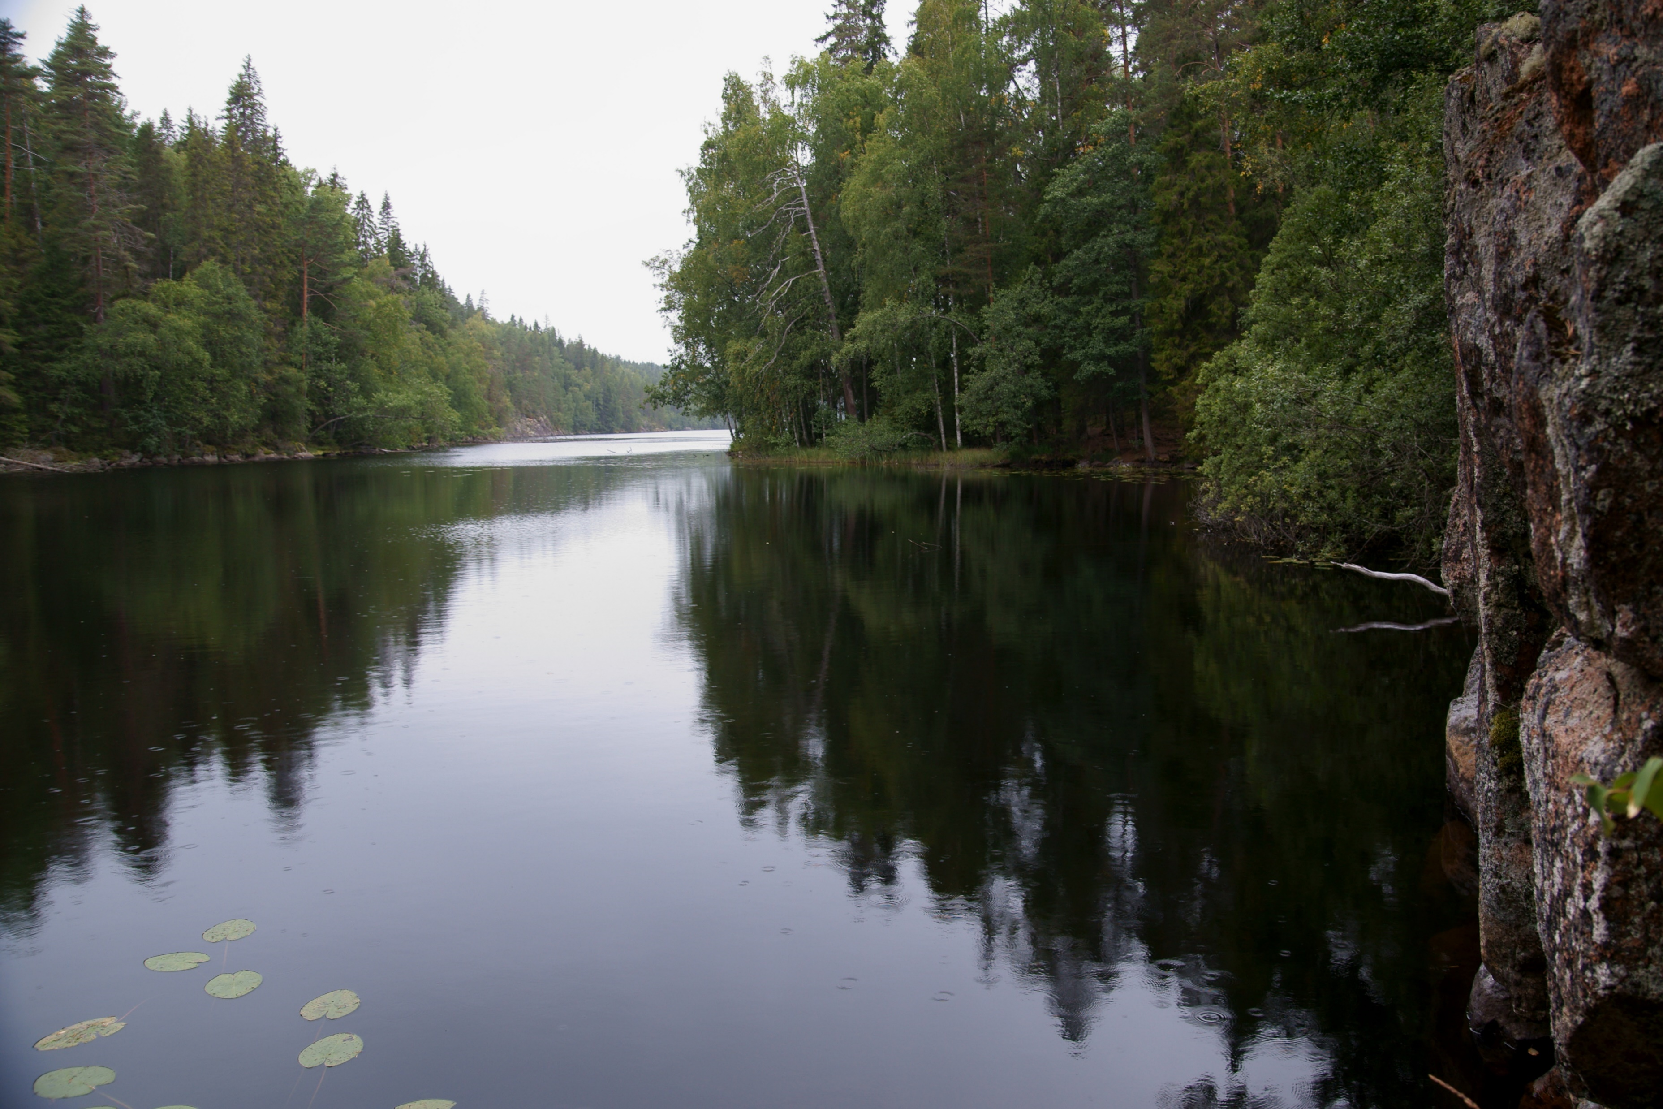
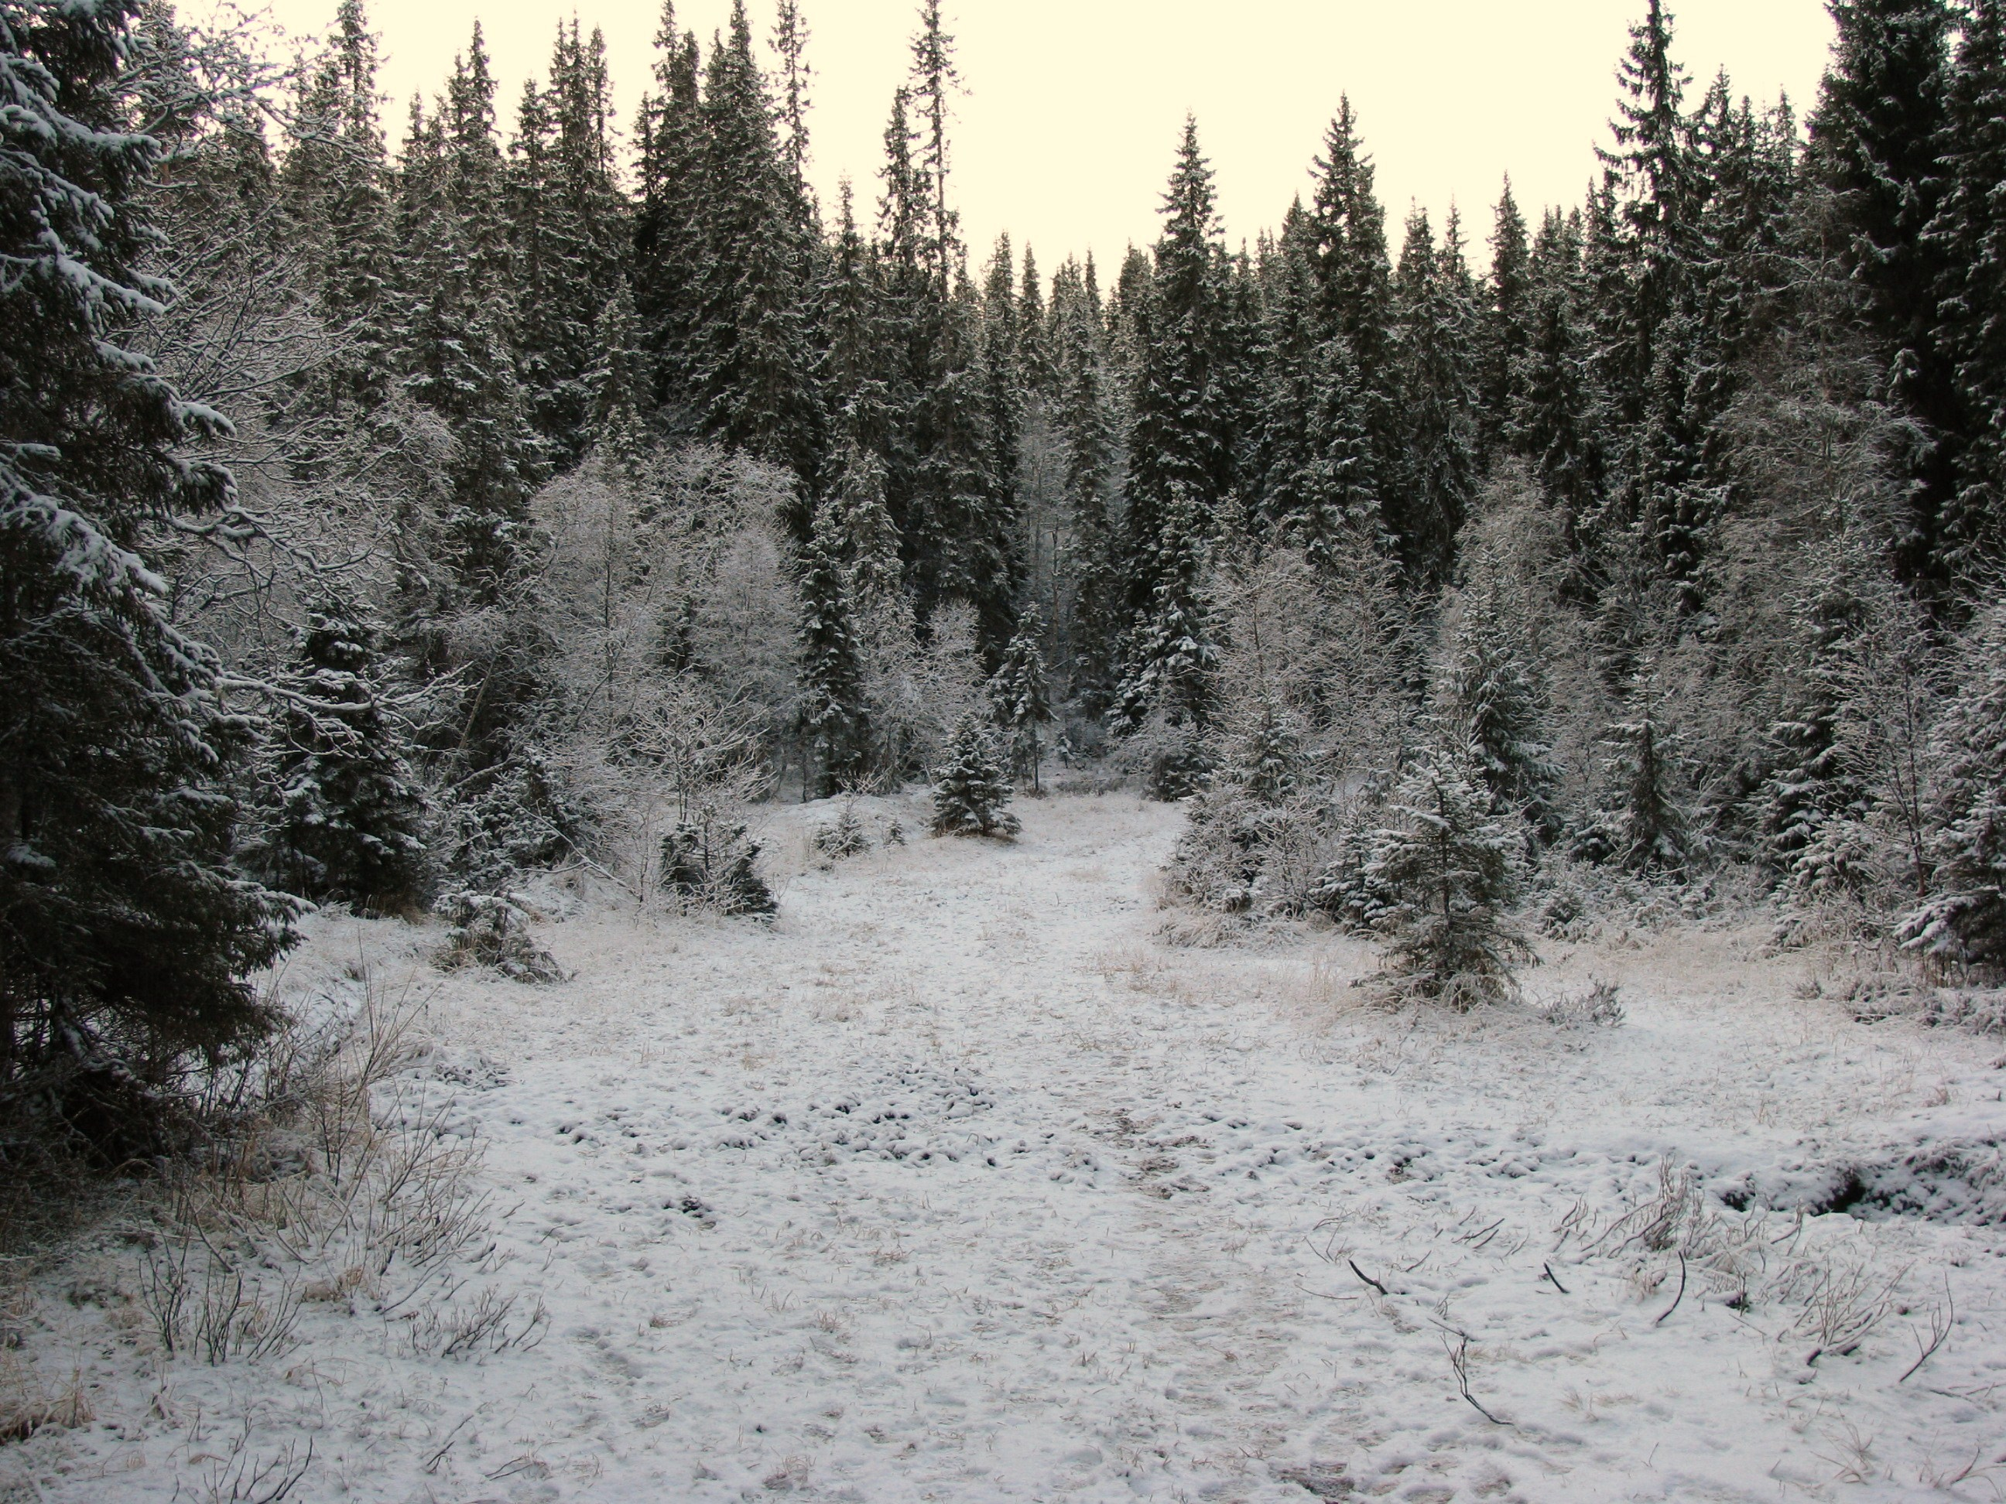
Taiga: Weather
Long, bitterly cold winters and short, mild, wet summers is the typical weather in this region. It rains a lot in the Taiga regions and they fall as snow in the winter and rain in the summer. Precipitation: 10-30 in. yearly

Slide 3
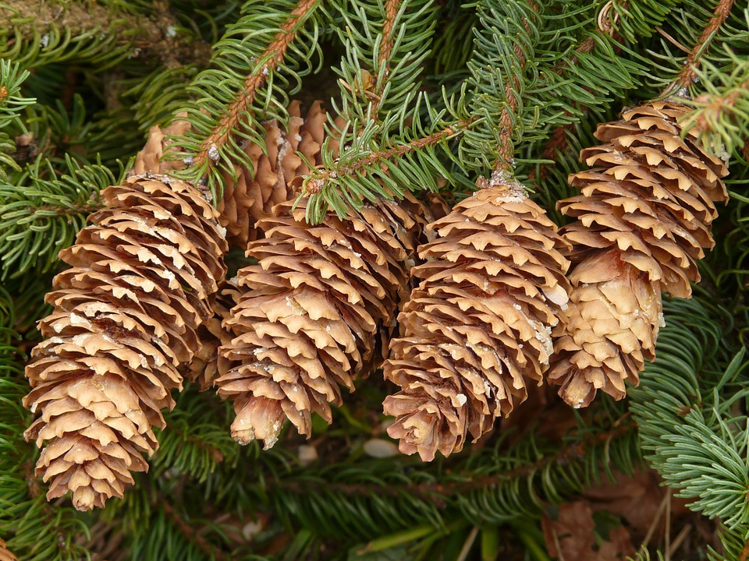
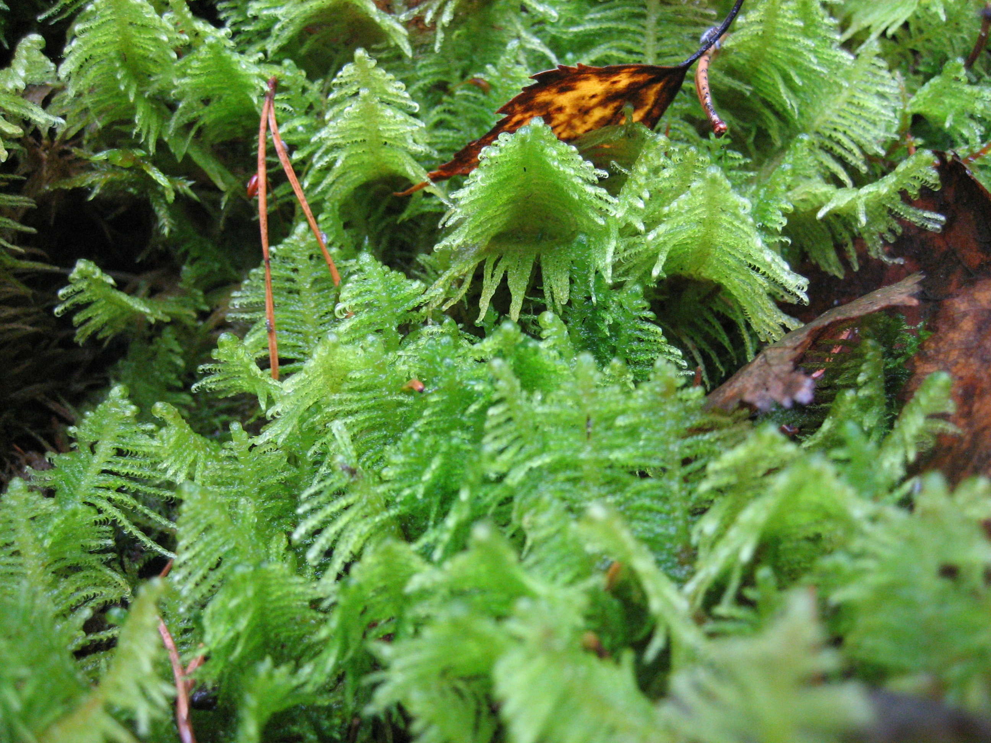
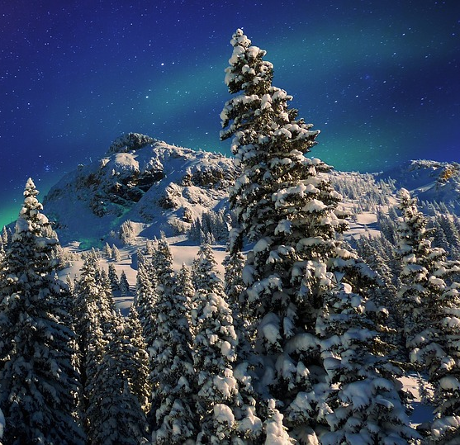
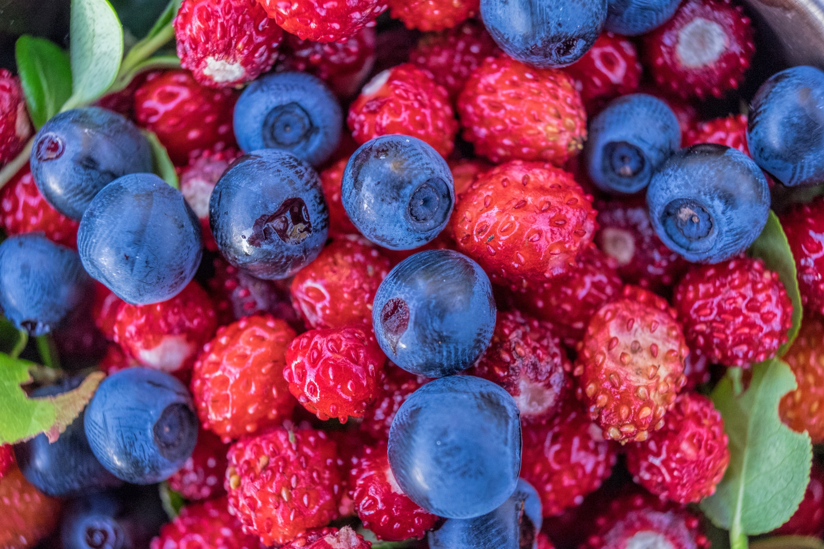
Taiga: Plants
The main plant you can find in this biome is the coniferous evergreen trees which include spruce, pine, cedar, and fir trees. They grow very close together forming a canopy like an umbrella over the land and they produce their seeds in cones. Under the canopy of trees, other plants grow such as ferns, sedges, mosses, and berries.
Coniferous trees grow in a cone shape which help the snow slide off their branches.

Slide 4
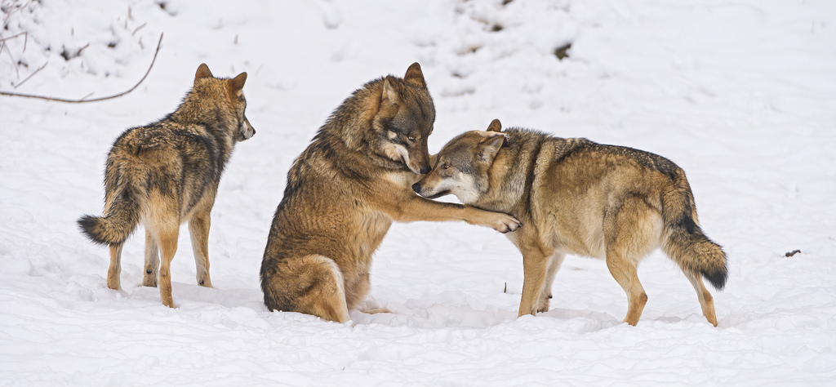
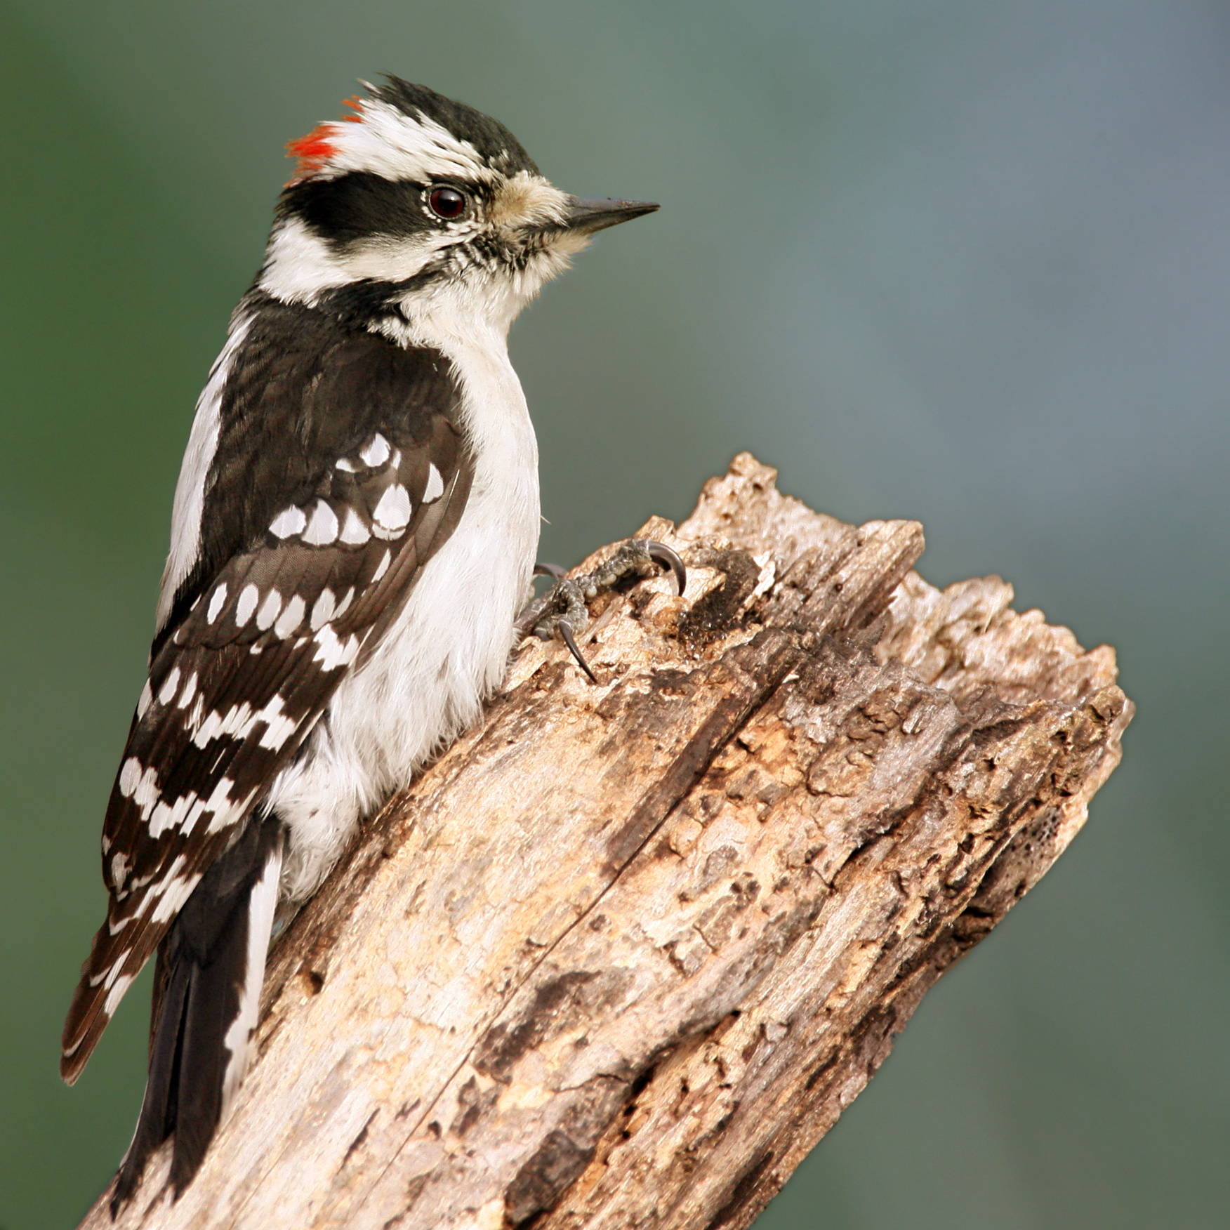
Taiga: Animals
Animal populations are mainly squirrels, jays, deer, moose, elk, grizzly bears, wolves, lynxes, and wolverines, bats, and woodpeckers.
Characteristics of the animals to help them survive in this biome:
Thick fur or feathers (to keep them warm)
Sharp claws (good at climbing trees)
Large feet (to walk on snow without sinking)

